Slide 1
PASSWORD MANAGEMENT SYSTEM
INNOVATIVE EXAM PPS
AI&ML GROUP 4
Names

Slide 2
Presentation Outline
What is password management system and its benefits?
Software used for Implementation
Identified Inputs
Identified Procedure & Function
Demonstration of Code
Results & Analysis
Conclusion
Credits

Slide 3
What is a password management system and what are its benefits?

Slide 4
What is password management system?
A password manager is a computer program that allows users to store and manage their passwords for local applications and online services.
They helps users to create secure passwords and automatically login to websites easily and securely.
Dedicated password managers have existed since the mid to late 1990s. Web Confidential was probably one of the first programs to facilitate password management, when it first surfaced in 1998. All major browsers added this feature in the early 2000s.

Slide 5
Benefits and Need of Using a password manager
1. One password to rule them all :A password manager stores all your passwords in a single place So you have to just remember your master password of the management system and find all of your passwords there.
2.Generate random passwords: Password managers can generate random passwords for each of your accounts. Password cracking programs are designed to guess the most common passwords first, so completely random passwords will always be far stronger than those you come up with off the top of your head.
3.Simple Access to multiple account:You can login to accounts easily. Once you sign up for a password manager, you can install a browser extension that will autofill logins for you while still storing them securely.
4.Easily change your password:Password managers make changing or resetting passwords a breeze. If a website you have an account with has been hacked, you can stay secure by using a built-in password generator to create a new password

Slide 6
Software used for Implementation

Slide 7



Software used for Implementation

Slide 8
Identified Inputs

Slide 9
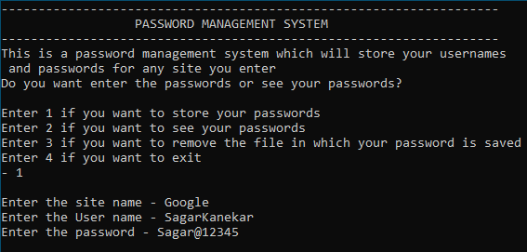
Identified Inputs
Required details we input in our program are
Does user want to enter the passwords or store there password User entering Its Site name and password

Slide 10
Identified Procedure & Function

Slide 11
Identified Procedure & Fuction
• Data Types:-
• In the c programming Language, a Data Type is often defined as a group of values with similar characteristics. All the values during a data type have equivalent properties.
• The memory size and type of the value of a variable are determined by the variable data type.
• In C program, each variable, constant or array must have a data type and this data type specifies what proportion memory is to be allocated and what type of values are to be stored therein variable or constant or array.
• There are 4 types of Data types in C programming Language
I. Primary Data Types (Basic Data types or Predefined Data types)
II. Derived Data Types (Secondary Data Types or User-Defined Data Types)
III. Enumeration Data Types
IV. Void Data Types
1. Integer Data Type:
• This Data Type comes under Primary Data Types.
• The keyword ‘int’ is used to represent integer data type in C language programming.
2. Float Data Type:
• This Data type comes under Primary Data types.
• The keyword ‘float’ is used to represent float data type in C programming language.
• The float data type is used to declare a variable which can store decimal numbers.

Slide 12

Output of the code

Slide 13
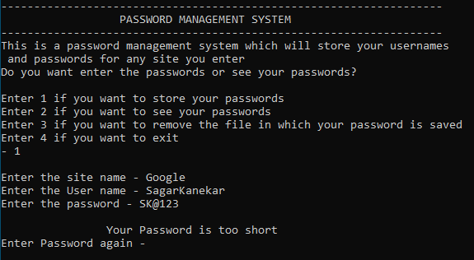
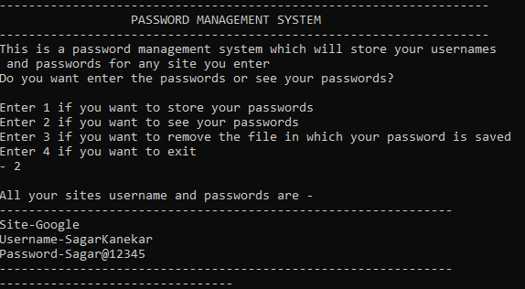
OUTPUT

Slide 14
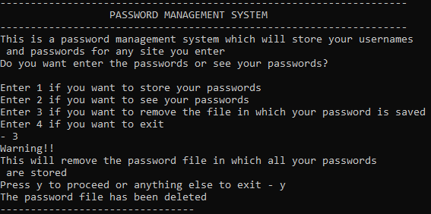
OUTPUT

Slide 15
References

Slide 16
References
https://www.geeksforgeeks.org/
https://www.programiz.com/
https://wikipedia.org

Slide 17
Conclusion

Slide 18
Our Conclusion
By making the PPS Innovative Exam project we learned theory and application of many important features in C language like functions, data types and strings.
Understood the Process of make a simple and efficient C program that’s Efficient reliable.
Application of Integrated Development Environment(IDEs) like Neovim and VScode
Importance & Usefulness of Git which is Used to work from different devices on a single project together simultaneously.

Slide 19
Credits
Names
Thank You…

